Slide 1
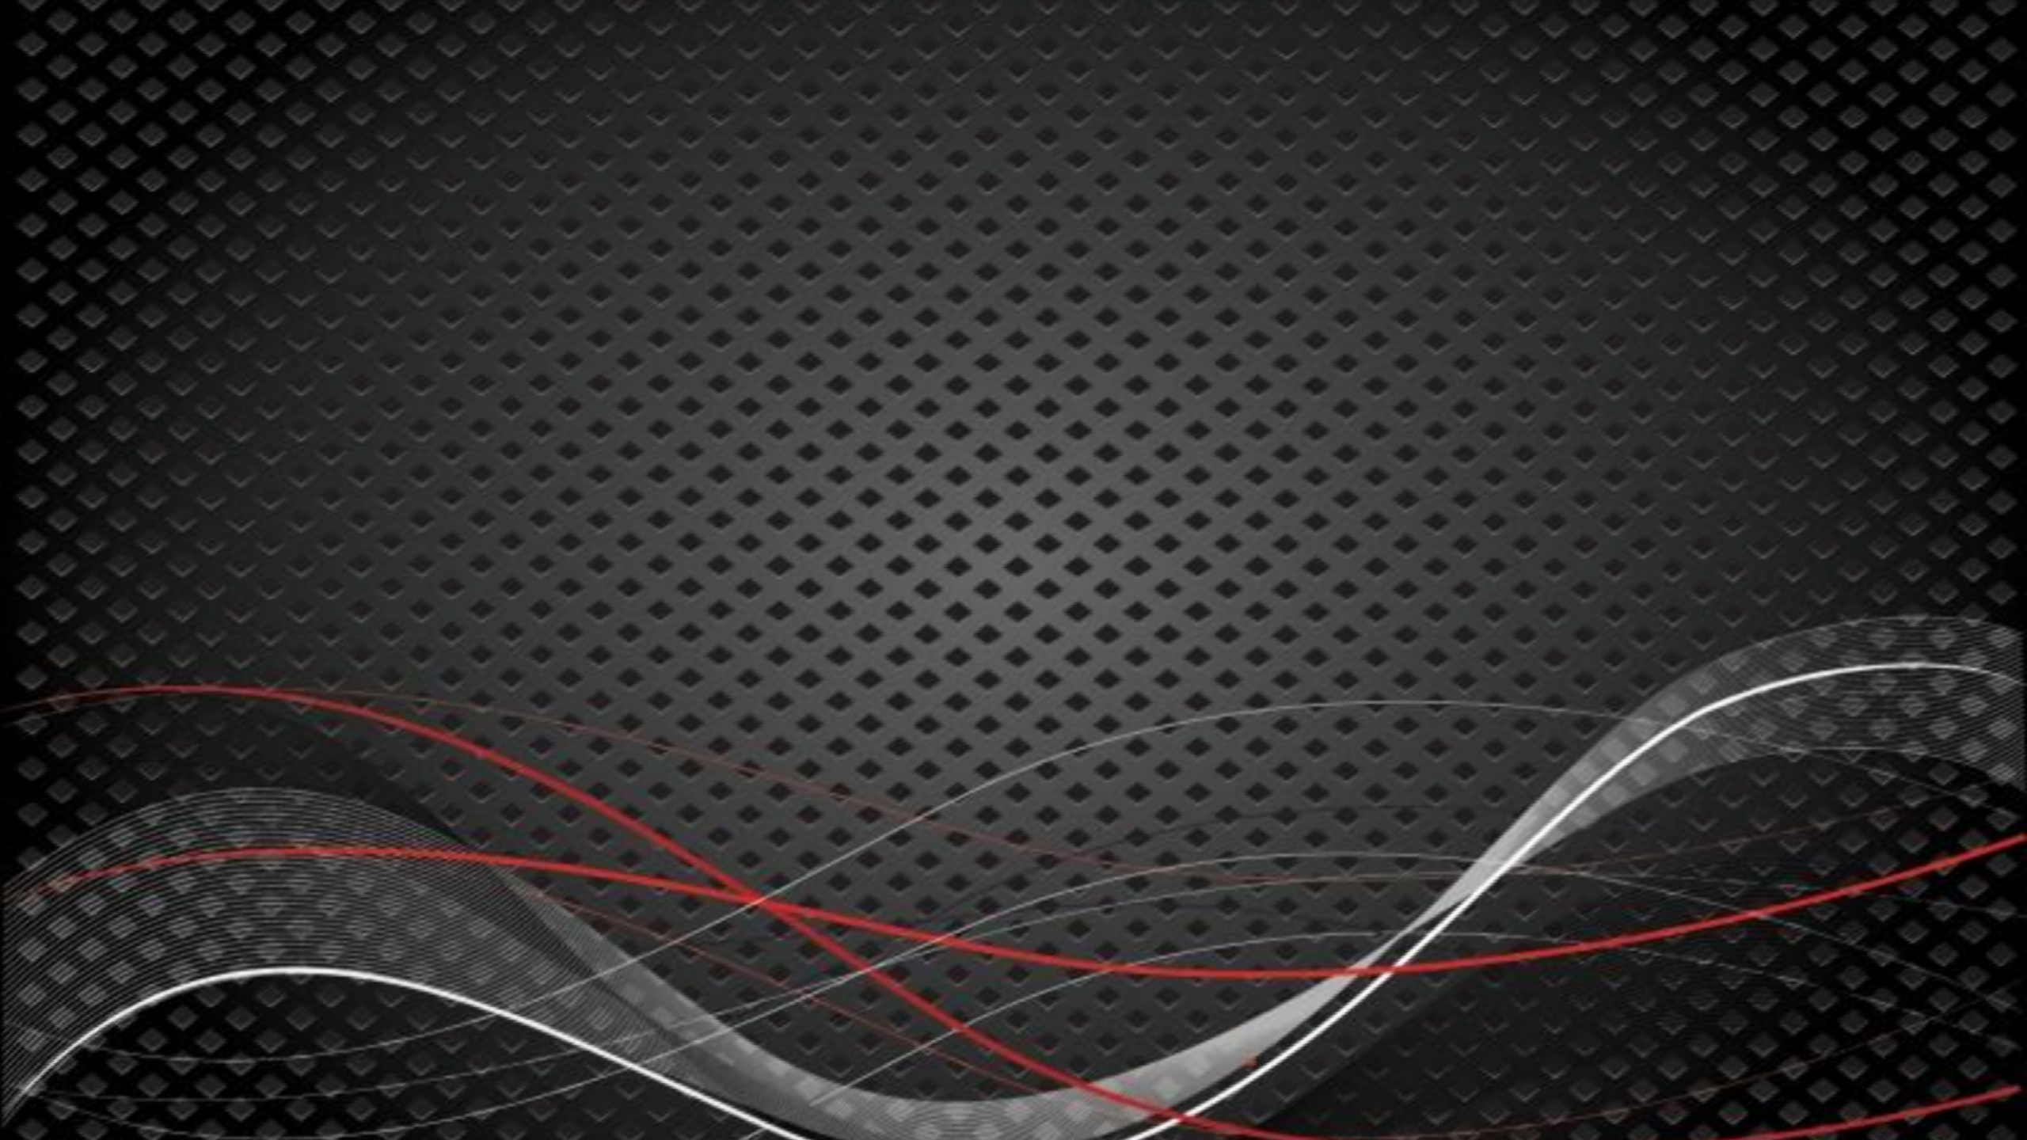


Slide 2
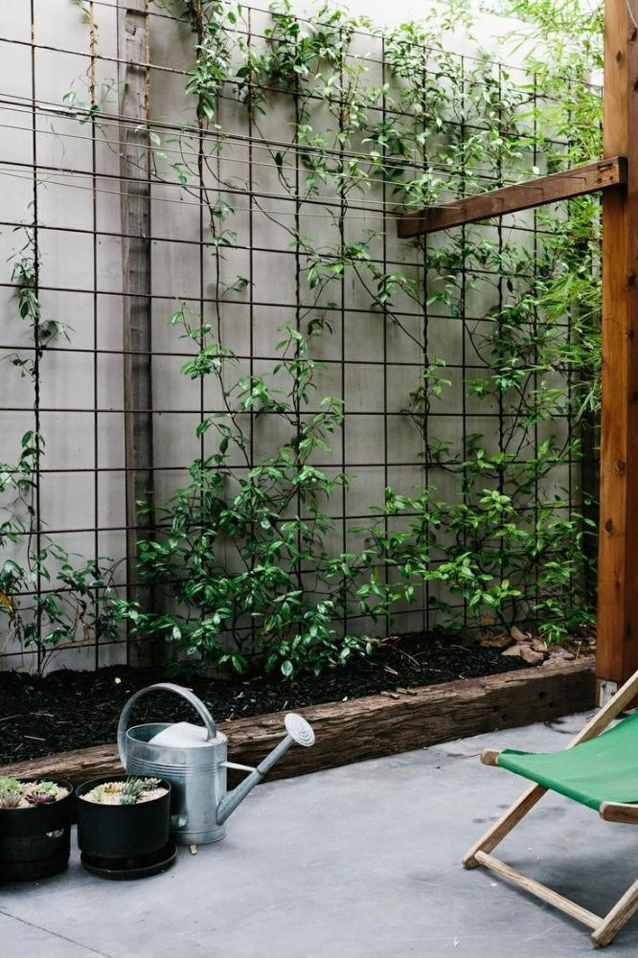
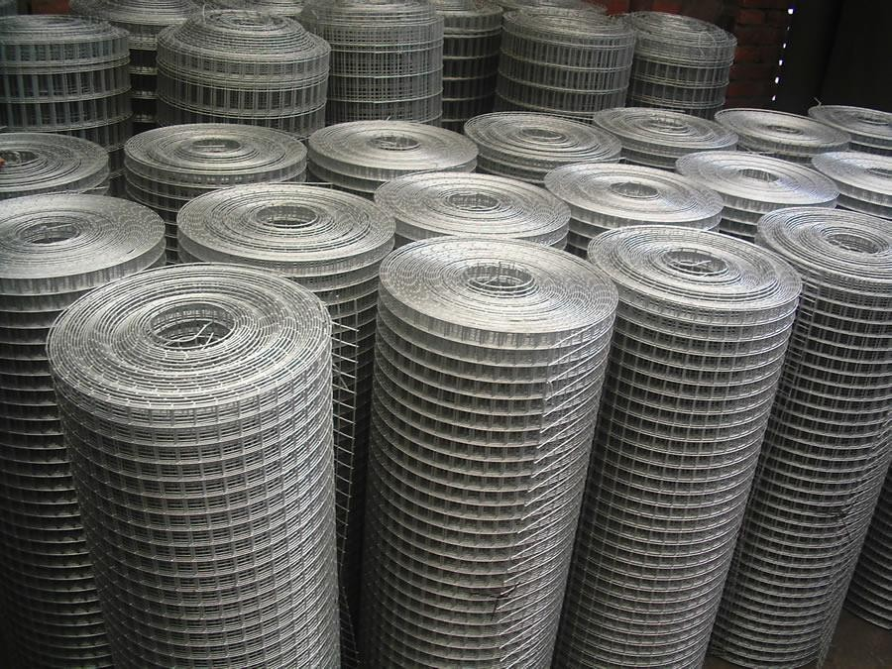
Introduction
With cost down production process, excellent transport facilities and wide distribution network, we, "Micro Mesh", started our business operation in the year 1996. Since our inception, we have been relentlessly catering to the specific requirements of the customers with impeccable quality products and services. We are an acknowledged manufacturer and exporter of Woven Wire Cloth and Wire Netting, Crimped Wire Mesh, Circular Screen/Filters for Plastic and Rubber Extrudes, Chain Link Fencing, Welded Mesh, Perforated Sheets and Expanded Metal, S.S. Wire Mesh and Hardware Mesh.
The key factors for which we received admiration from our customers include:
Timely Delivery
Ethical Business Policies
Best Quality Products
Follows Law
Trust
Efficient Communication
Corporate Image

Slide 3


MISSION
To promote and develop wonderful Wire Mesh Products, to exceed the high expectations of the customers to our product.

Slide 4

VISION
To be a leading manufacturer of S.S. Wire Mesh and Wire Mesh Products in India by its best Quality, Growing Sustainably and Delivering value to all our customers.

Slide 5
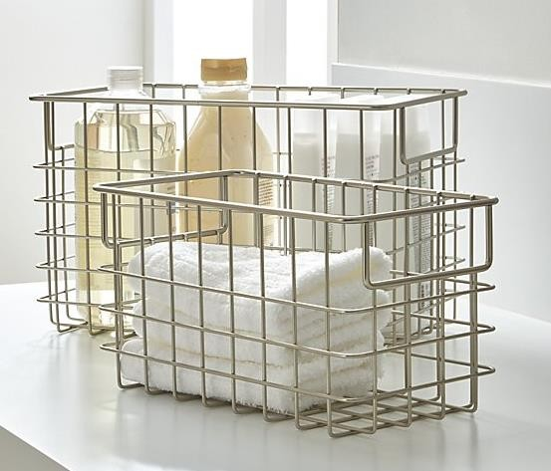

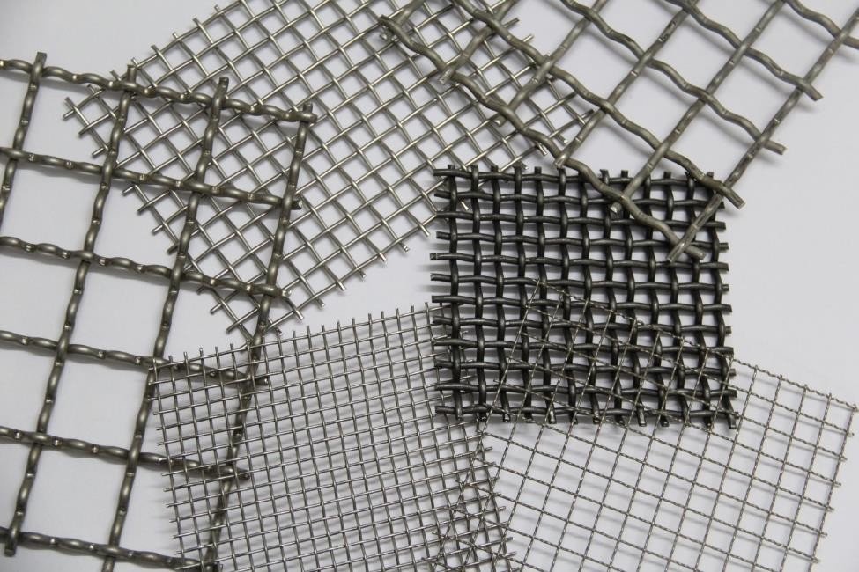

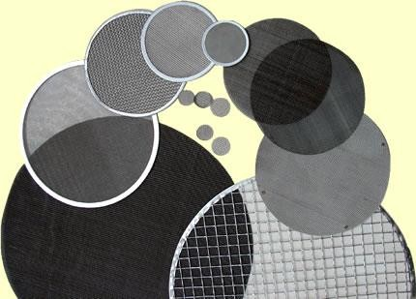
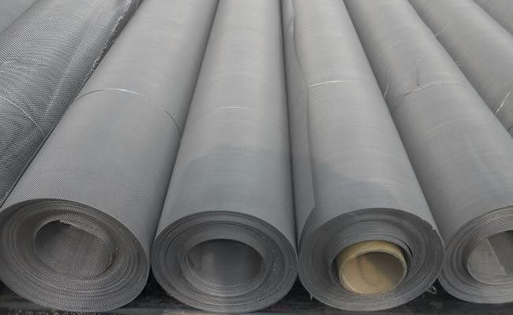
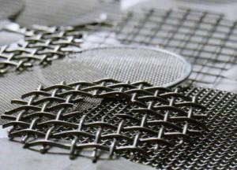
APPLICATIONs
PRODUCTS

Slide 6
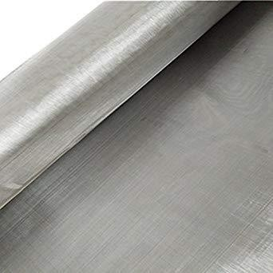
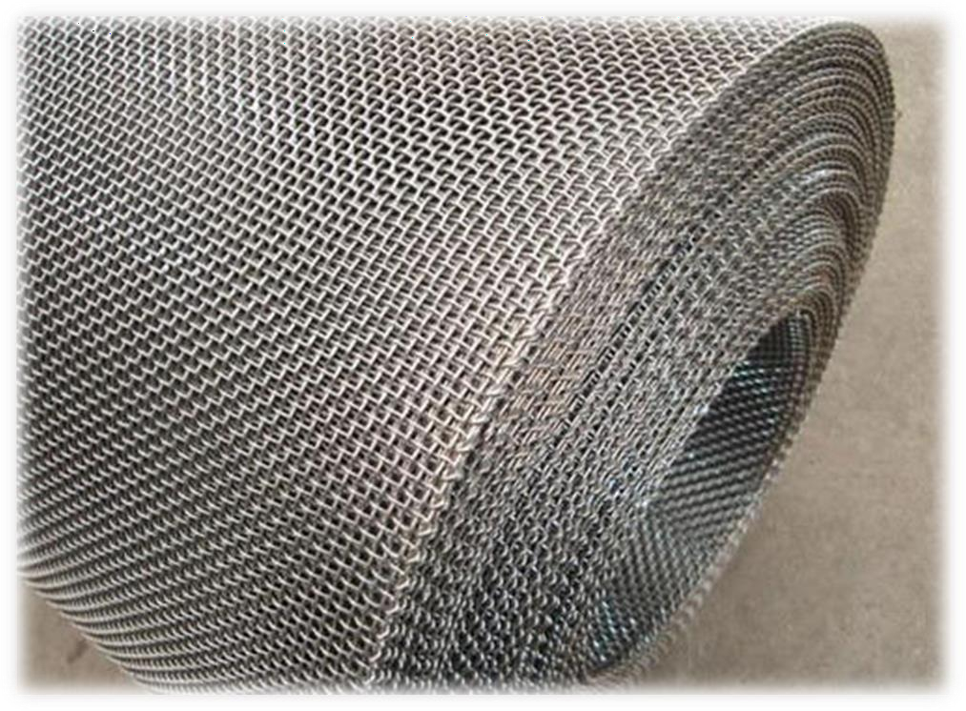
S.S. WIRE MESH
Micro Mesh as best stainless steel wire mesh manufacturers in India, offers wide range of Wire Cloth with varied aperture sizes and weaves. Their texture also varies from being fine, soft and flexible as silk to as rigid as steel plate. They are available in rolls or in cut circles and also as fabricated filters. On request, we can also provide the same in some other metals like Monel, Nickel, Hastelloy, Phosphorous Bronze, Copper and Brass. As a result, we have carved a niche for ourselves as one of the most prominent Wire Mesh Manufacturer,

Slide 7
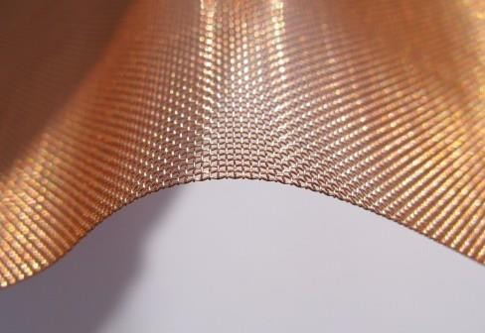
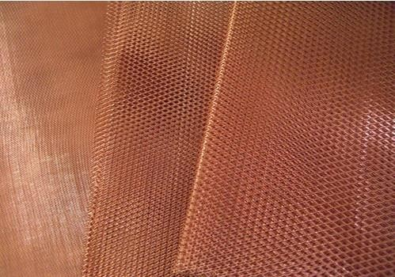
COPPER WIRE MESH
Copper Wire Mesh’s unique colour makes it a very popular option for many different types of users, including designers, artists, architects and home owners. Home owners and designers opt for copper woven wire mesh for residential projects including gutter guards, soffit screens, insect screen, fireplace screen, or even custom manufactured infill panels or decorative wall panels. Sculptors, wood workers, metal artisans and architects also prefer copper mesh because of its remarkable dark amber-red colour and its broad appeal to a wide audience.

Slide 8
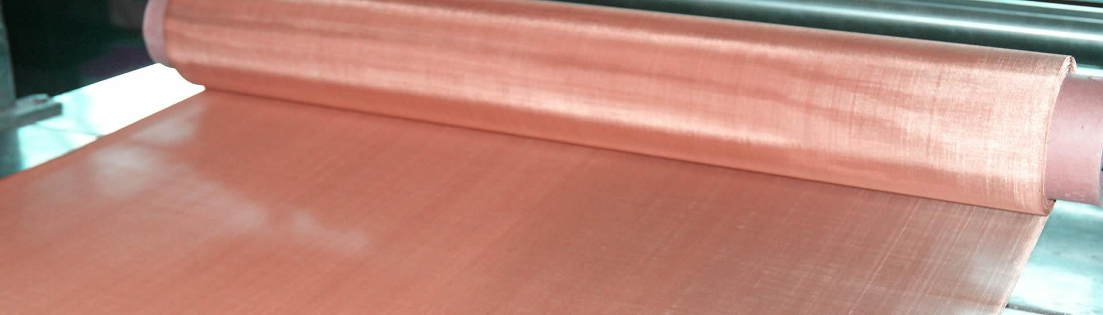
MAJOR APPLICATIONS
Without a doubt, copper wire mesh is critical to many industries, and it is often at the centre of technological advancements in a broad range of fields. Over the past few years, customers have selected various copper mesh specifications for use in:
Energy storage
Robotics & power automation Pest control fumigation
Electric heaters
Gamma irradiators
Health, body and mind enrichment
Metalsmithing & Bookbinding
Air & liquid filtration and separation

Slide 9
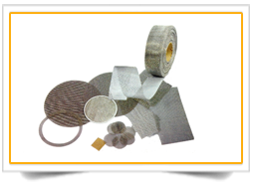
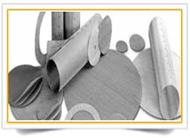
WIRE MESH FILTERS
Wire mesh filter has a greater number of finer wires in the shute direction and is woven in both plain and twill weave patters. It is normally rated by the size particle it will retain, either as the absolute micron rating or the nominal micron rating, expressed in microns.

Slide 10
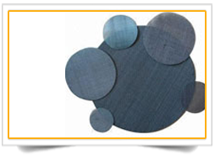
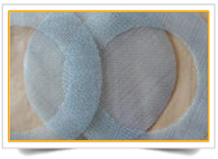
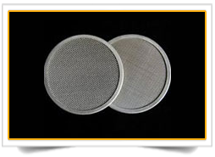
MAJOR APPLICATIONS
Filter wire cloth is utilized as filter fittings for rubber and plastic industries, chemical industry, medicine, petroleum, telecommunication, scientific research units etc. are used for Polymer Filtration with precise mesh size to suits your machine requirements, as well shape..

Slide 11
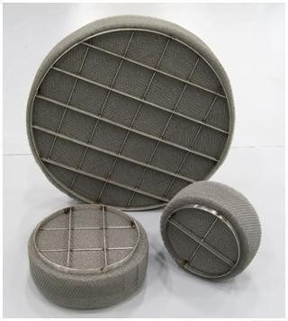
DEMISTER PADS
Demister Pad fabricated Pad formed from symmetrical interlocking Loops of knitted metal wire or plastics filaments. This pad with the high free volumes and large impingement area can be installed in any new process vessel to provide separation efficiencies up to 99% for particles down to five microns, with pressure drop with vicinity of 25 mm WC. The HAST mist eliminators is a static, in-line device and in majority of cases it can be installed in evaporators, scrubbers, pressure vessels etc. , without a special housing.
At HAST we have a full of range of mist eliminators (demisters) to ensure tailor made solutions for your applications.

Slide 12
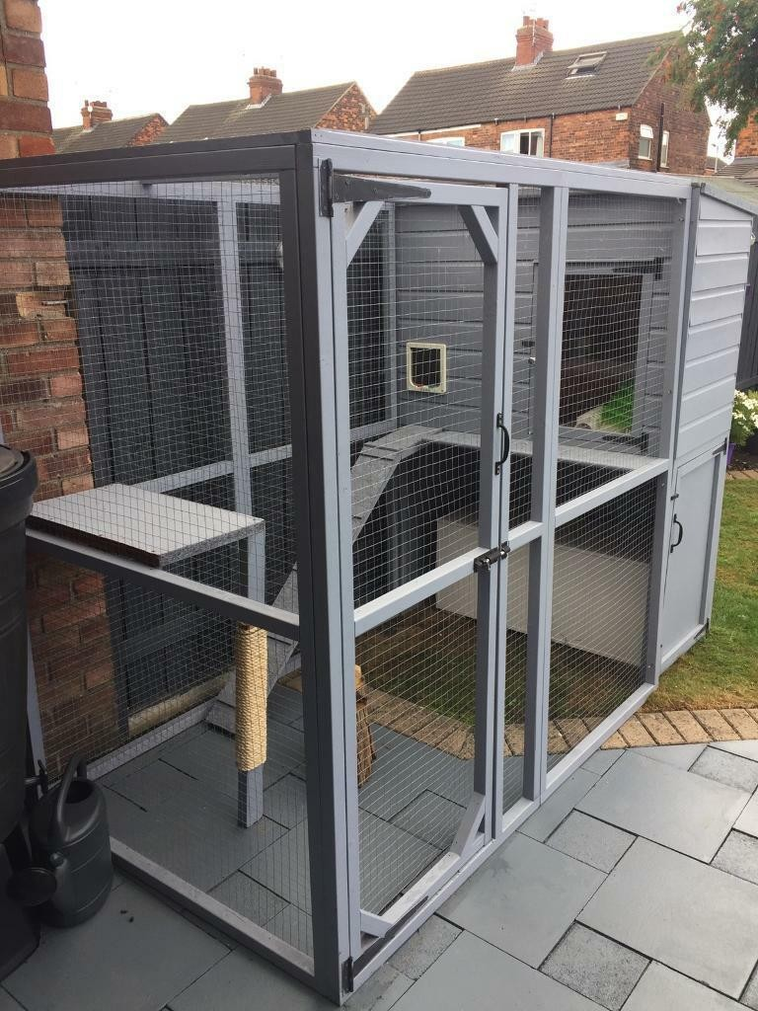
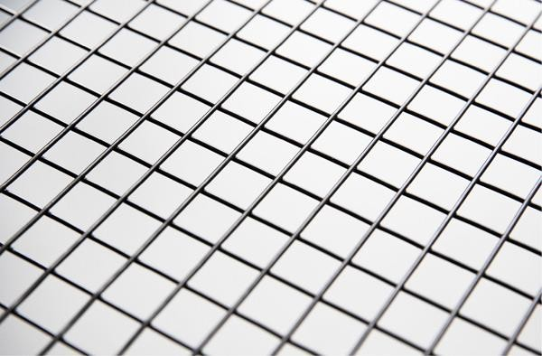
Welded Wire Mesh
The welded wire mesh is a metal wire screen that is made up of Mild Steel wire, Galvanised Steel in hot dip or cold dip and Stainless Steel wire of 304, 316L grade. It is an automatic process with sophisticated welding technique, laid horizontally and vertically, individually at welded at every intersection. It is available in various sizes and shapes.

Slide 13

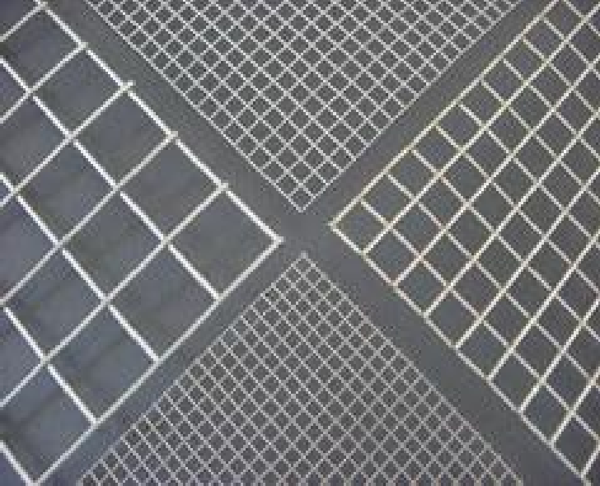
Specifications of Weld Mesh:
MESH |  | WIRE GAUGE
INCH | Mm | Mm
1x1 | 25mm x 25mm | 2 mm TO 3mm
1x2 | 25mm x 50mm | 2 mm TO 6 mm
1x3 | 25mm x 75mm | 2 mm TO 6 mm
2x2 | 50mm x 50mm | 2 mm TO 6 mm
2x3 | 50mm x 75mm | 2 mm TO 6 mm
3x3 | 75mm x 75mm | 2 mm TO 6 mm
4x4 | 100mm x 100mm | 2 mm TO 6 mm
5x5 | 125mm x 125mm | 2 mm TO 6 mm
6x6 | 150mm x 150mm | 2 mm TO 6 mm
8x8 | 200mm x 200mm | 2 mm TO 6 mm
10x10 | 250mm x 250mm | 2 mm TO 6 mm

Slide 14

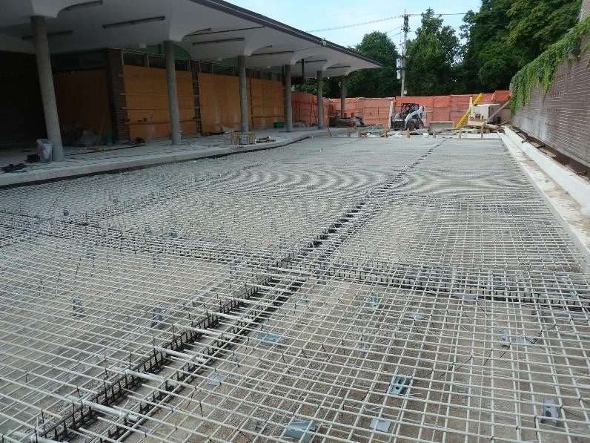
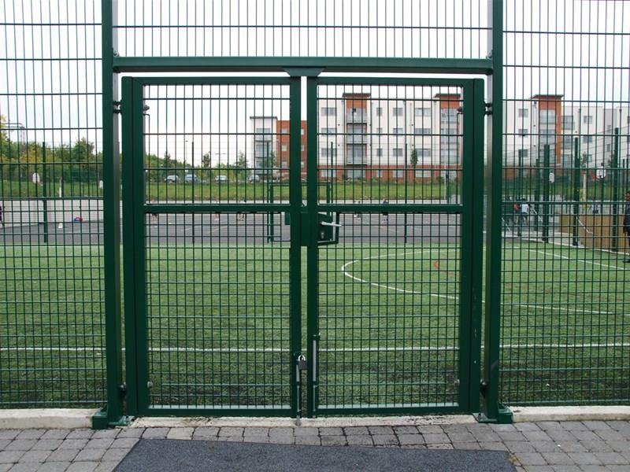
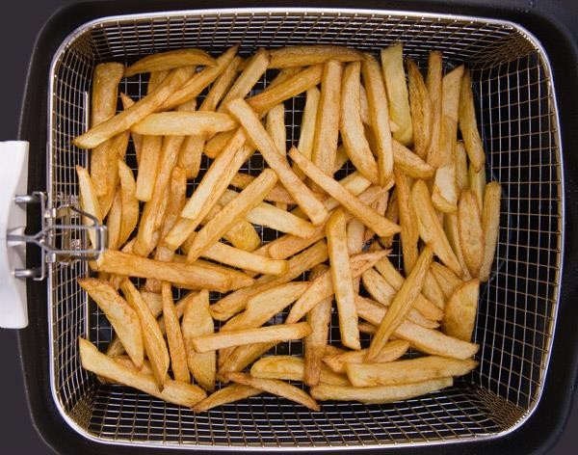
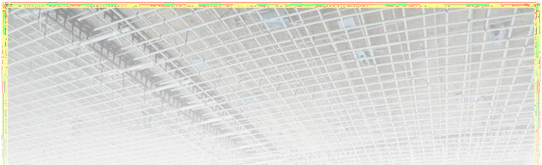
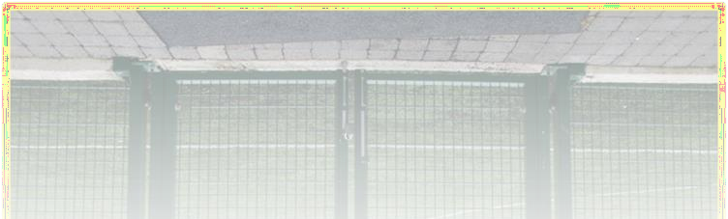
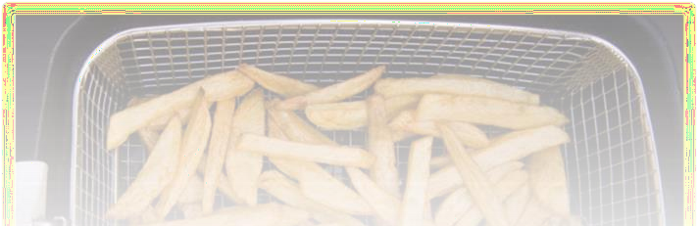
MAJOR APPLICATIONS
It is widely used in Agricultural, Industrial, Transportation, Horticultural, Runway Enclosures, Draining Rack, Fencing and Food Procuring Sectors. It is also used in Mines, Concrete, Gardening, Machine Protection and other Decorations.

Slide 15

























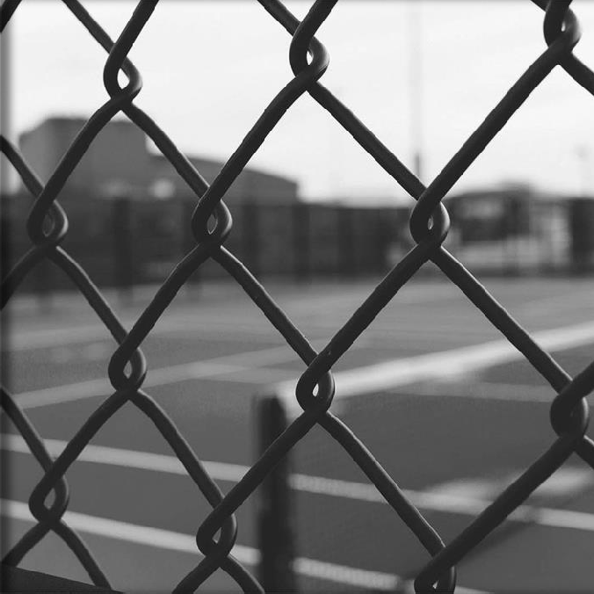
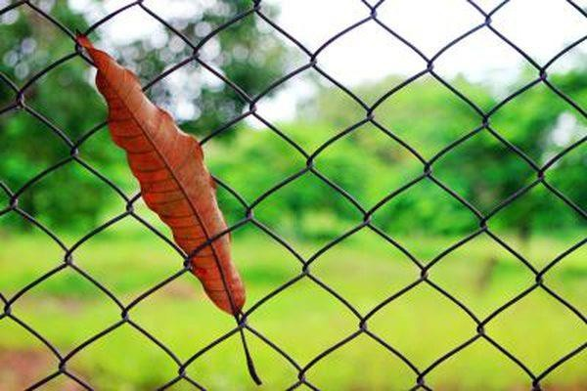
CHAIN LINK

Slide 16
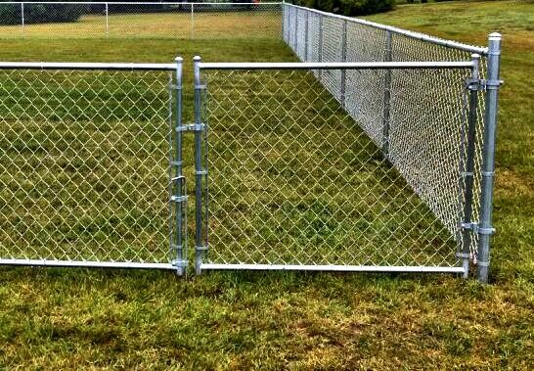
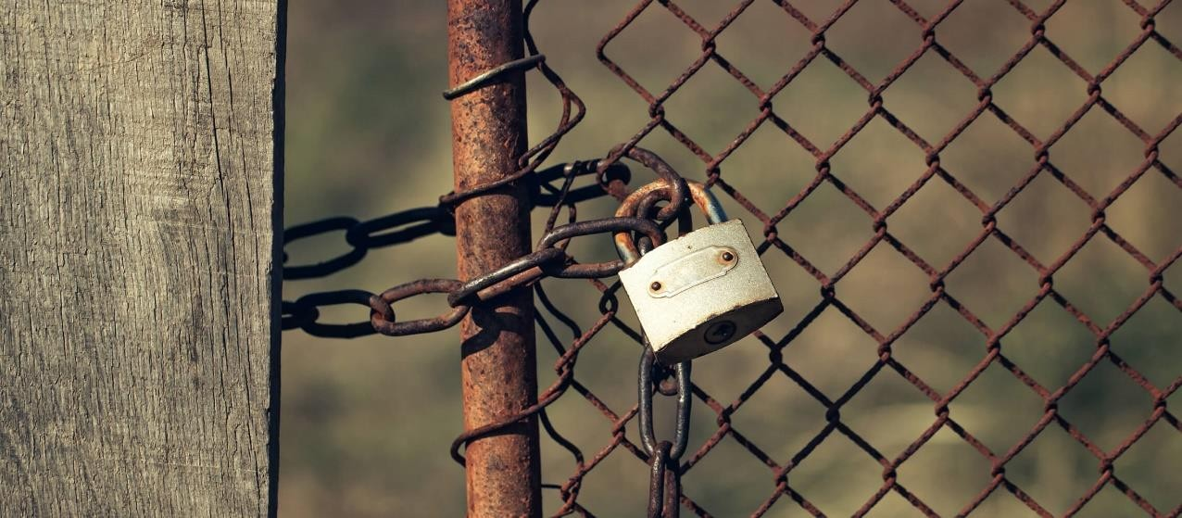
MAJOR APPLICATIONS
Installing a chain link fence is a popular choice for both home and business owners. Not only it is easy to install, it also serves many purposes, particularly security. It is a functional, affordable, and versatile option. Common uses for chain link fencing:
Defining Boundaries
Containing Animal and People
  Proving Security
    Sports Field
Industrial Buildings and Factory

Slide 17
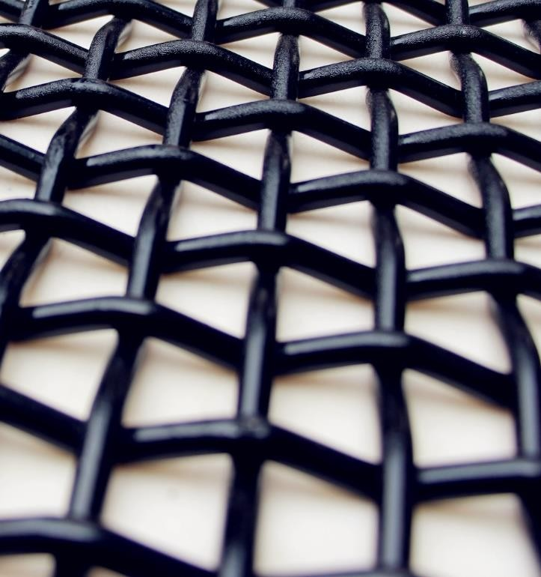
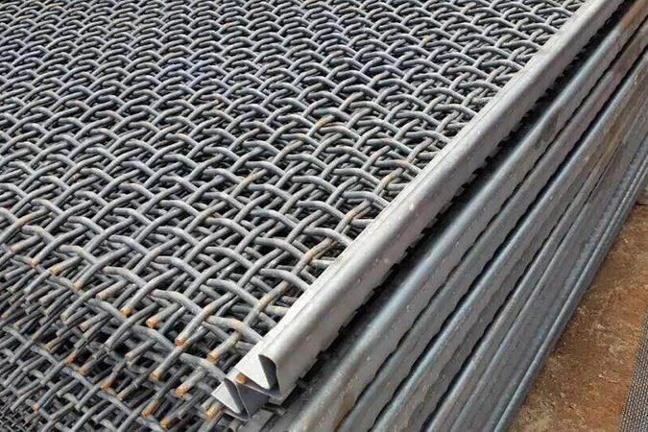
CRIMP WIRE MESH
Lock crimped wire mesh is a refinement of the intermediate Crimped Wire Mesh. It is made in a variety of materials through Crimping Mesh Machine, a kind of universal wire products with square or rectangular openings. Our crimped wire mesh products are made of Stainless Steel Wire, Galvanized Wire and High Carbon Spring Steel.

Slide 18
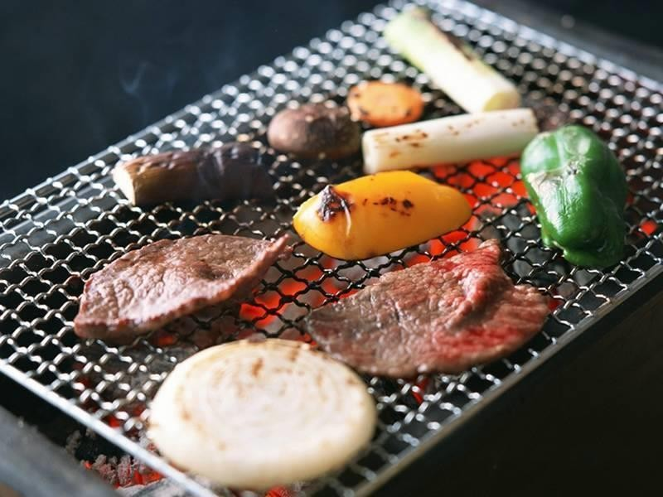
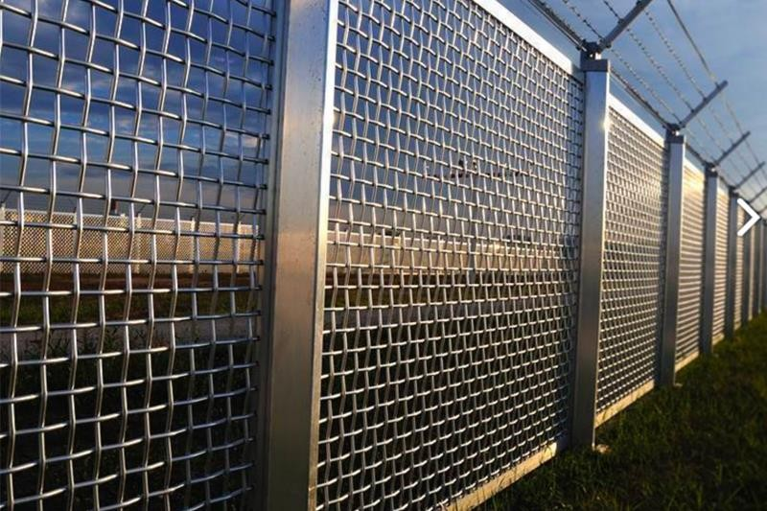
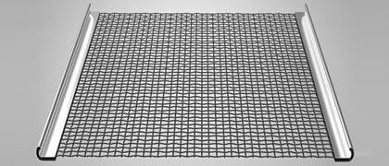
MAJOR APPLICATIONS
Crimp Wire Mesh is famous for its design. Although, it has some of the amazing applications that the consumer needs to go for crimp wire mesh. Crimp wire mesh used in Mining Sector, Stone Crushers Zone, Fencing, Food Industry etc.

Slide 19
Companies working with…..
Filtration Industry
Mahle Anand Filter Systems Private Ltd (Gurgaon)
Mahle Anand Filter Systems Private Ltd (Pune)
Luboil Filtration Systems Pvt Ltd
SMS Filtron (P) Ltd
Mectech Process Engineers Pvt Ltd
Filter-Sep Technologies
Puromatic Filters Pvt Ltd
Multitex Filters Pvt Ltd
Multitex Filtration Engineers Ltd
Roop Polymer Ltd
Filtration System Solution India Pvt Ltd
Rotex Automation
Chaddha Industries
Copper King International (Ambala)
Hitech Filters
Lynx tools and components Pvt ltd

Slide 20
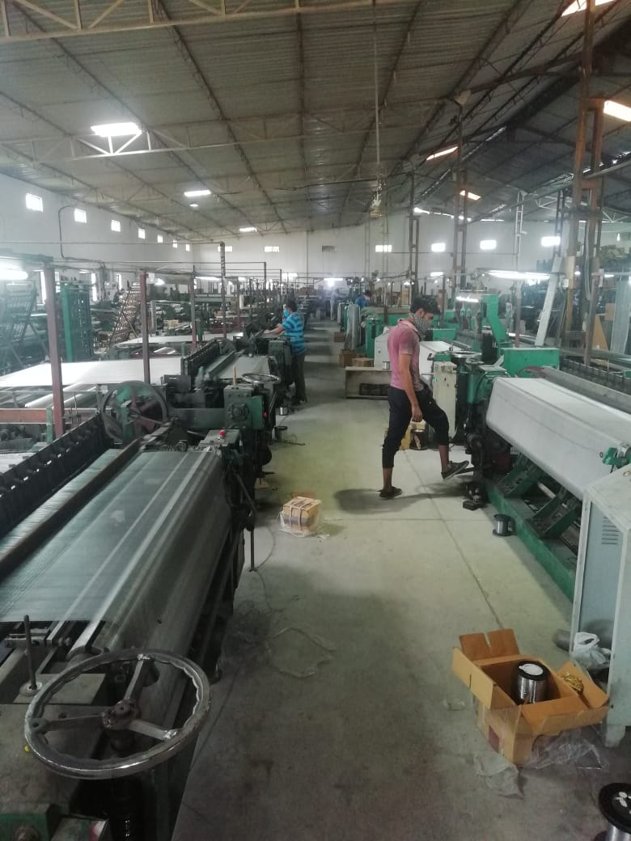
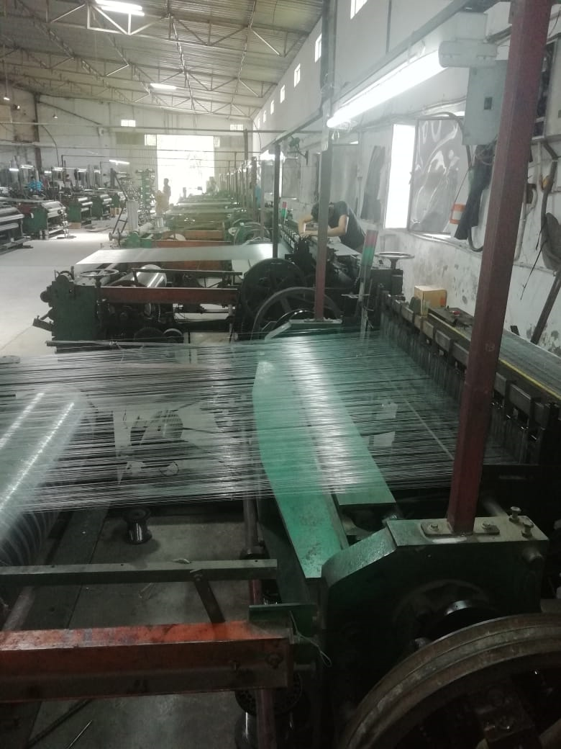
Insights….

Slide 21

MANISH JAIN
Director
Factory Add: #121, Sector-6, IMT Manesar, Gurgaon- 122050
Contact No.: 91-9810253450 E-Mail ID: info@microwiremesh.com

